Slide 1

Notes:
Change any of this you feel appropriate: especially adding pictures of your own MC if you can: personalising is good – it leads to first-person stories.

Slide 2

Programme
9.45 onwards drinks / welcome
10.00 intro, story, q&a’s, sharing experiences
11.40 coffee and crafts
12.30 lunch break
1.15 presentation - ongoing story, next steps, & group work
2.15 q&a
2.40 Bible story
3.00 leave

Slide 3
How did it all begin?
At one Anglican church near Portsmouth
Dreamed of a way of being church to appeal to the whole family
Listening to the needs of local people
Building on resources of the church and the building
April 2004: first Messy Church
Notes:
It would work well to show the Fresh Expressions DVD clip after this slide (available from the Messy Church website) and to allow a short time to reflect in small groups

Slide 4
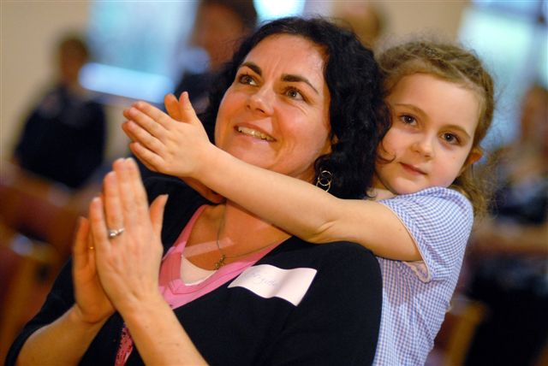

The Shape of Messy Church
Once a month on Thursdays
3.30 welcome
4.00 crafts
5.00 celebration
5.15 meal
Notes:
Different Messy Churches meet on different days and use the timings differently. Details can be found on the MC website in the Directory

Slide 5

Aims …
To provide an opportunity for people of all ages to worship together
To help people of all ages feel they belong in church and to each other
To help people have fun and be creative together
To introduce Jesus through hospitality, friendship, stories and worship
Notes:
All these are crucial to ‘core’ Messy Church

Slide 6
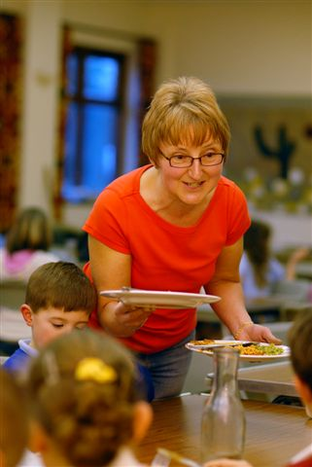

Values
Creativity,
hospitality,
celebration

Slide 7

Cornish Pasty
(not started yet)
Why are you thinking of starting Messy Church?
What do you think will be your main challenge?
How do you think Messy Church might change your community?
What would you love to see happening in your Messy Church five years from now?

Slide 8
Cornish Pasty
(already started)
What were your reasons for starting Messy Church?
What would you say were the main difficulties and problems you've had or still have?
What would you say are the biggest successes you've had or are having?
What would you love to see happening in your Messy Church five years from now?

Slide 9



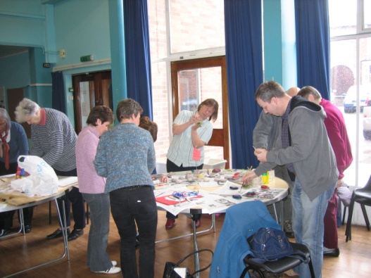


Fresh Expressions DVD
Messy Church book
Messy Church website
Messy Fiestas
Messy Church 2
Notes:
The Fresh Expressions DVD was made, featuring Messy Church in 2004, making MC known across the world as the Fresh Expressions Team showed it on tours
In 2005 Messy Church the book was published, giving churches a framework to work from.
The website was launched in about 2007 when the need for it was obvious – a place to share ideas and experiences.
Messy Fiestas – training days for those thinking about or involved in Messy Church started to be run by Barnabas.
Messy Church 2 was published in late 08.

Slide 10

September 2008
Going deeper... Going wider
BRF’s Barnabas found funding for Lucy to work fulltime on Messy Church:
To make Messy Church and its aims better known
To support Messy Church leaders through Regional Coordinators, the website, Fiestas, a two-way flow of ideas and prayer
To discern what God is teaching the Church through Messy Church

Slide 11
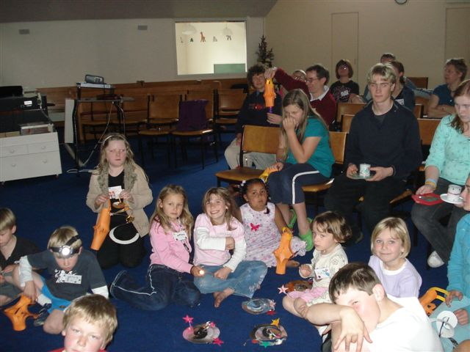

Regionally
Nationally
Internationally
Rochdale, Didcot, Hanham, Bournemouth, Hellifield, Newport, Brixham, Dawlish, Meade Vale, Bristol, Truro, Poole, Lymington, Exeter, Manchester, Buckingham, Saltburn, Hammer, Sea Mills, Warwick, Wolverhampton, Hayes End, Grimsby, Epsom, Polegate, Camborne, Kegworth, Rixton, Westgate on Sea, Christchurch New Zealand, Cowplain, Lightwater, Morden, Epsom, Westgate, Beccles, Cambridge, Kilburn, Surbiton, Lydd, Colchester, Hundon, Brookwood, Petersfield, Wootton, East Ham, Strood, Claygate, Oakley, Farnborough, Codsall, Grimsby, Redditch, Shipston on Stour, Macclesfield, Raunds, Lilleshall, Carlisle, Barrow in Furness, Wythenshawe, Liverpool, Jarrow, Neath, Leith, Stranton, Alderley Edge, Newcastle, Norton, Bebbington, N Aylsham, Sutton Coldfield, Newfoundland... (251 listed in Dec 09)
Notes:
The concept soon caught on and the Directory features just a few of the Messy Churches that exist. You might want to change this page for examples of your own regional MCs

Slide 12
Revd Dr Steven Croft, Bishop of Sheffield:
... I believe it is one of the most significant developments in fresh expressions of church at the present time. ... Messy Church deserves every encouragement and support.
Revd George Lings, Director of Church Army’s Research Unit – The Sheffield Centre:
Messy Church is important within the current re-imagination of what it is to be Church. Don't dumb it down to kids, crafts and church-lite. It fosters inherent participation by contrast to congregational passivity. It connects across the generations instead of 'sending the children out'. It offers a holistic vision of church by weaving together community and creativity, out of which comes appropriate liturgy. This is positively different from laying on worship into which the attenders are assimilated. Moreover its spread shows it is accessible and transferable to many contexts. It has much to teach us all.

Slide 13
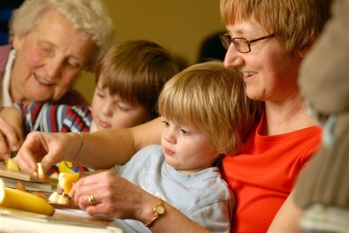
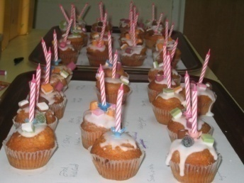

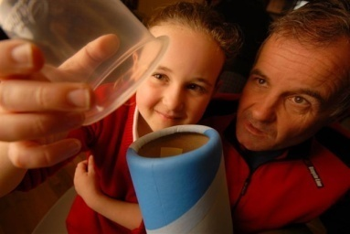
  Helping Church grow
  Could our church services be messier?
  How important is food to fellowship?
  How much should we strive to be all-age?
  What about liturgy?
  What does this say about women?
  What about lay leadership?
  How do we do faith at home?
Notes:
These are some of the questions Messy Church makes us ask. (Non-Anglicans may not be bothered about the liturgy question! Indeed many Anglicans probably aren’t….) The really big learning curve is the faith at home q: once a month isn’t enough to be a disciple to we need to find ways to help people follow Jesus at home and at work and school

Slide 14
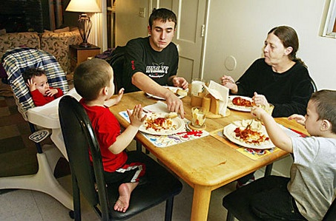
Faith at home
Were you brought up in a Christian household?
How do you know?

Slide 15

How does / could the Church help families
bring their children up in the faith?
What Christian ‘disciplines’ do you think would help families in your area follow Jesus more closely?

Slide 16
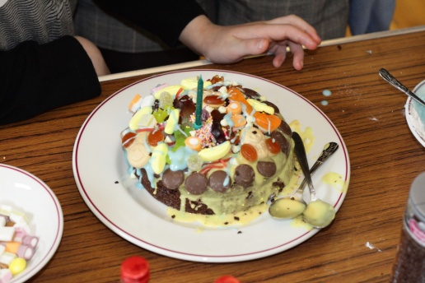
Getting Going
Listening: Do you feel this might be what God’s calling you to?
How will you listen to your community?
What gifts does your church have?
Planning: When is the best time for your Messy Church?
Where is the best place for it?
Expectations: How many do you expect to come?
How will you publicise it?
Team: List the people you will invite onto the team.
Core team (3/4)
Welcomers
Craft leaders
Cooks
Celebration leaders
Pray-ers

Slide 17
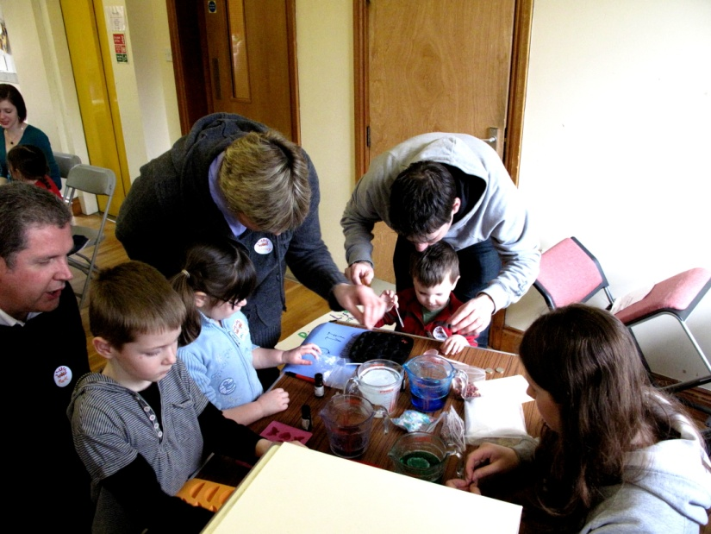
Getting Going ctd
Which of these do you need to do next?
Plan deadlines and who will do them where possible
Speak to ministers / elders
Speak to congregation
Get team commitment to pilot session
Date for pilot session
Book venue
Start publicity
Plan activities for pilot session (core team)
Plan date for evaluation session afterwards

Slide 18

www.messychurch.org.uk

